Slide 1

Using AI for Designing ID Cards Embedded with Invisible QR Code
Group No. 19
Dhruva Mhatre 18104045
Chirag Jain 18104002
Prem Vispute 18104059
Project Guide & Co-Guide
Prof. Kiran Deshpande
Prof. Kaushiki Upadhyaya

Slide 2
Contents
Introduction
Objectives
Problem Definition
Technological Stack
Review Suggestions (Given in Last meeting)
Proposed System Architecture/Working
Prototype Design Demonstration
Implementation Status
Status of Paper Draft & Targeted Conference

Slide 3
1. Introduction
Problem Identified :
  ID card contains personal information of the person (e.g. Mobile no. , address etc), this information can be misused if fallen into wrong hands.
Solution Proposed :
  In the proposed system, we generate a QR code consisting of the user info and embed it (Invisible QR code) in the user Photo on the ID card.

Slide 4
2. Objectives
To provide data security by data hiding.
To maintain integrity and readability of the ID card by hiding the QR code and providing necessary information.
To reduce data exposure and security threat.
To develop a QR code generator using pyqrcode module in python.
Embed the QR code generated in the required image using CNN.
Retrieve the embedded QR code from the encoded image.

Slide 5
3. Problem Definition
Identification cards or Id cards are the most important credential for any organization and it helps uniquely identify the person or verify them. But these ID cards contains personal information of the person (e.g., Mobile no., address etc.), this information can be misused if fallen into wrong hands. In our project we are proposing a system where we will generate a QR code consisting of the user info and embed it (Invisible QR code) in the user Photo on the ID card.

Slide 6
4. Technological Stack
Python (pyqrcode, NumPy, matplotlib)
CNN (Keras, Tenserflow, Relu, Pandas, NumPy, Matplotlib)

Slide 7
5. Reviews and Suggestions
To change title of the project.
Make title, abstract and intro ML based.
Add more CNN and ML related keywords.

Slide 8
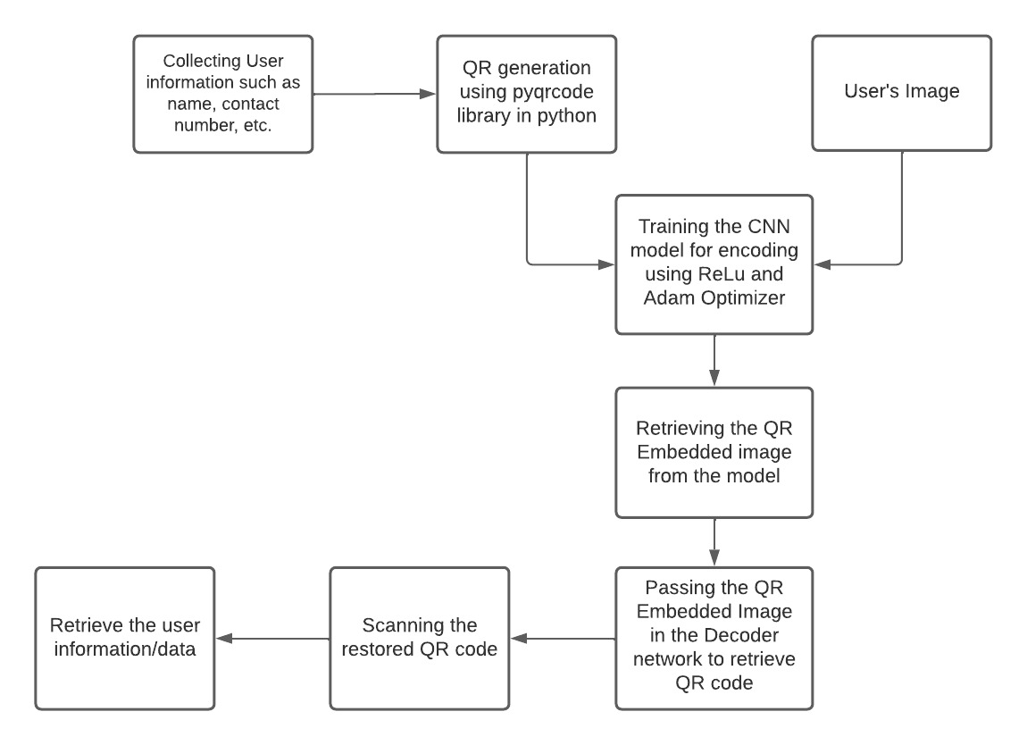
6. Proposed System Architecture/ Working

Slide 9
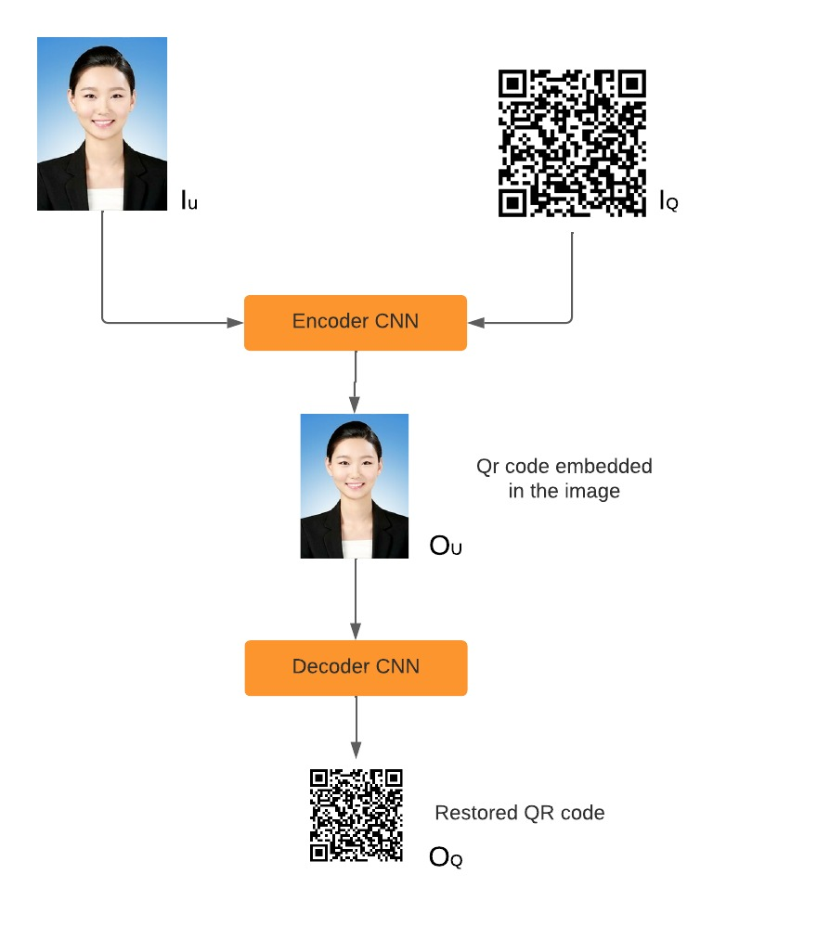
7. Prototype Design Demonstration (Desired)

Slide 10
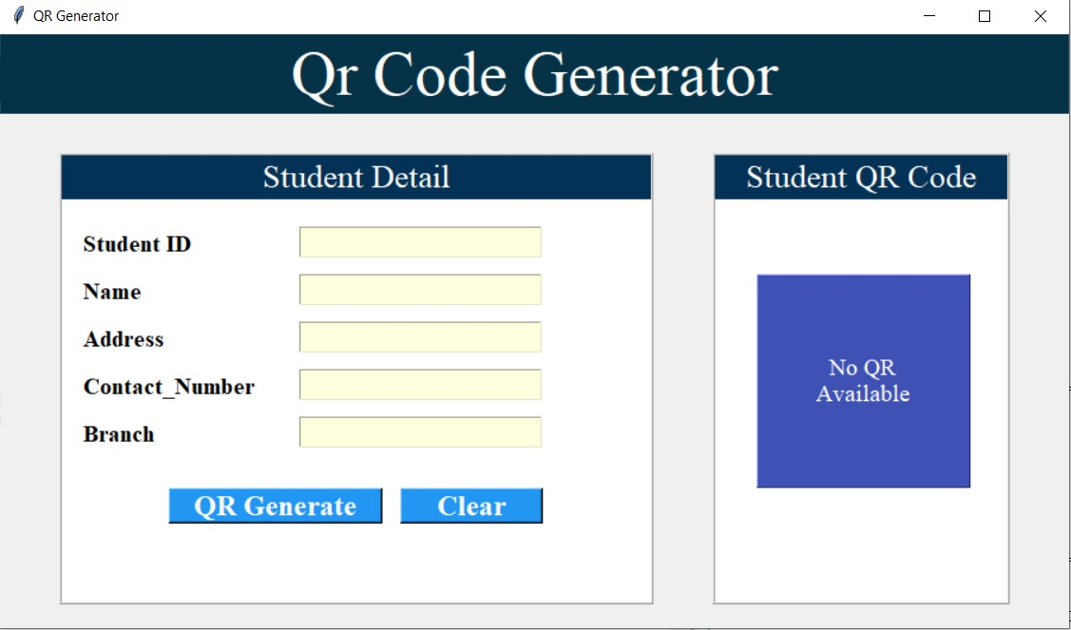

Slide 11
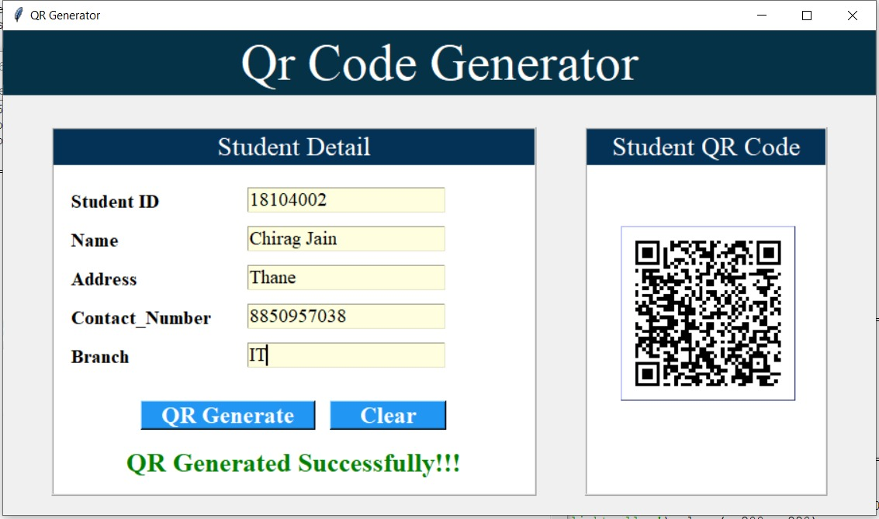

Slide 12
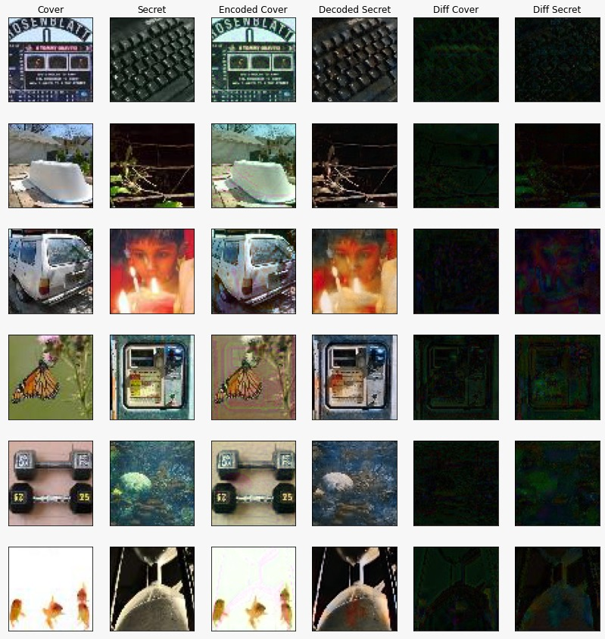

Slide 13
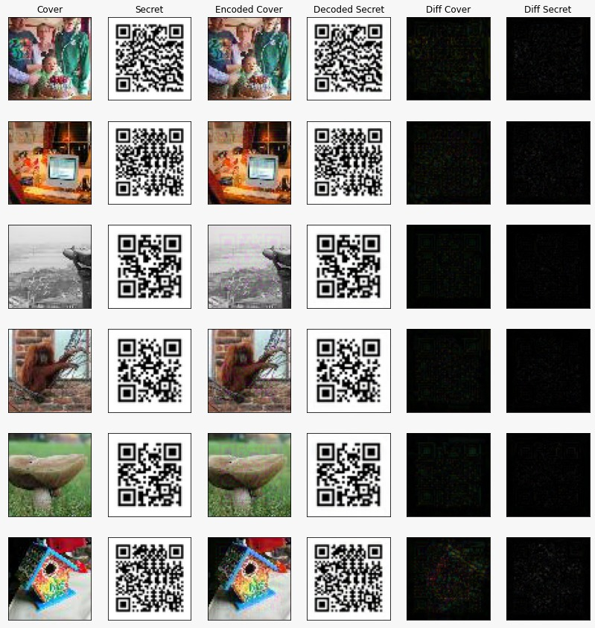

Slide 14
8. Implementation Status
1. Developed the QR code generator.
2. Trained CNN model for ImageNet dataset where it is able to hide the secret image into the carrier image.
3. . Trained Encoder-Decoder CNN models for QR code dataset and Tiny- ImageNet dataset, where encoding of the QR code into the Carrier Image is obtained successfully.

Slide 15
9. Status of paper draft and targeted conference
International Conference on Computational Intelligence and Innovative Technologies (ICCIIT – 2022) – Elsevier SSRN series

Slide 16
Thank You...!!

